Slide 1
PLAG-CHECK + SOFTWARE TESTING REPORT

Slide 2
Overview
This project endeavours to -
Help teachers check and avoid plagiarism among student’s assignments..
Any guest user can check for grammatical errors and plagiarism in their documents
A virtual classroom environment where teacher can post assignments and students can submit their assignments , teachers can then check for malpractices within submissions made by students.

Slide 3
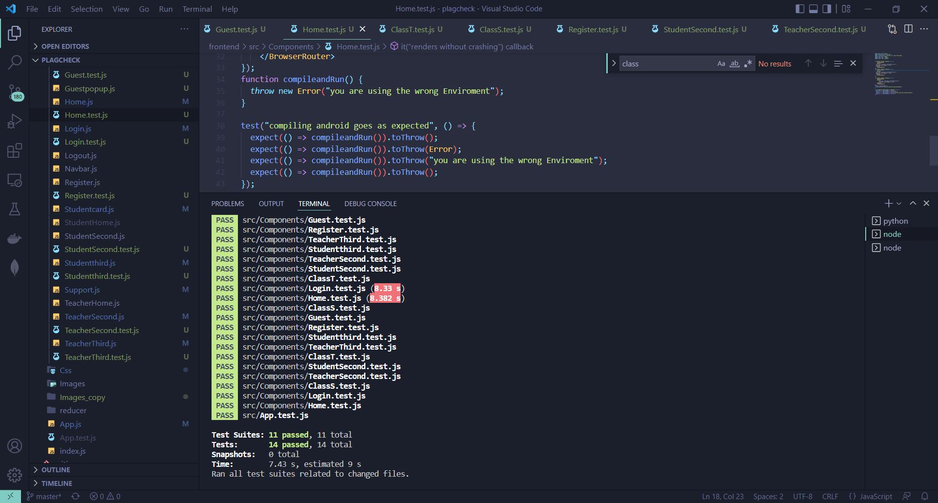
Unit testing
Testing
-allows us to confirm that our template is getting all the data it needs. We can check that we're using the intended template and what data the template is getting, which goes a long way to verifying that any rendering issues are solely due to the template.

Slide 4
Manual testing
Multiple test accounts were created to test the flow of entire web application
Guest User
Uploaded files for grammar and plagiarism check
Viewed the corresponding plagiarism and grammar check reports
Teacher account
Three classes were created
Multiple assignments were posted in all classes
Viewed created classes and assignments
Viewed submission of all students in multiple assignments
Viewed plagiarism report of submitted assignments

Slide 5
Manual testing
Student Account
Joined multiple classes created by teachers
Viewed assignments posted by teachers in respective classes
Submitted our final submission file corresponding to the given assignment
Viewed the final submission made by student
Scanned for grammatical errors within the submitted assignment
Taking the account through the complete process from signing up to testing every feature ensured that none of the features were breaking in production and that they were all working properly.
We employed various techniques to test input validation, including bug checks.

Slide 6
Integration Testing
To perform manual integration testing, we have individually tested all the modules and made sure that they are working properly in combination with each other.
We prepared a top-down flowchart of all the modules to check the flow of our web application.

Slide 7
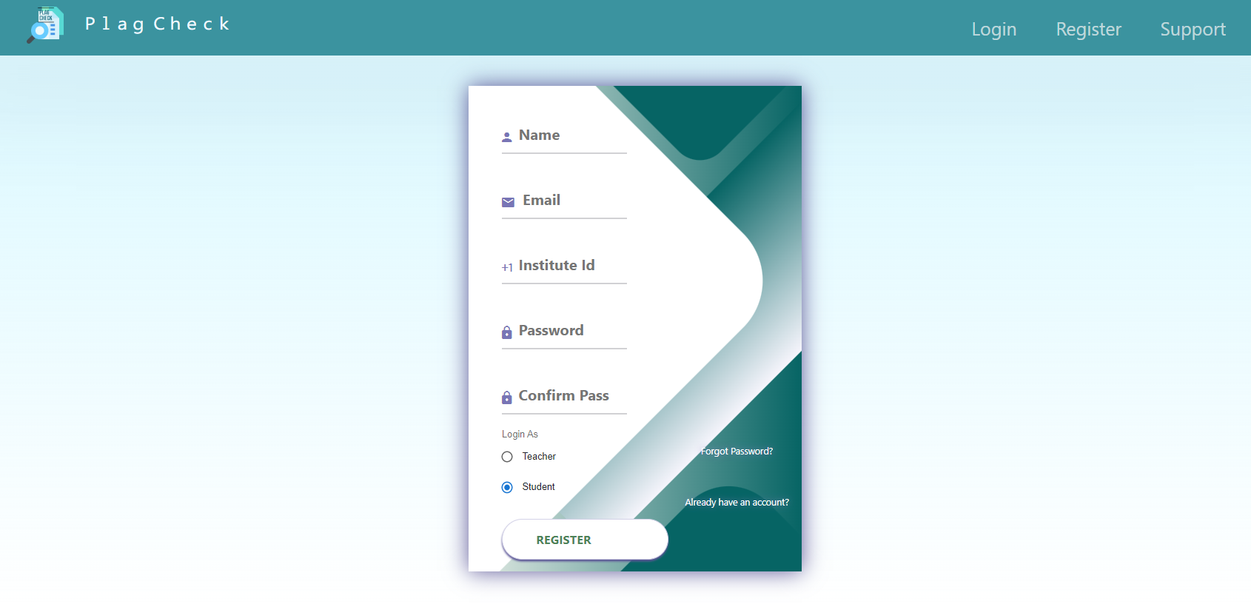
System Testing
We performed manual System testing on a complete integrated system to evaluate the compliance of the system with all the requirements.
We tested the design and behavior of the system and also the user experience.
1) USER REGISTRATION
TEST CASES | RESULT
User registration with new email id | Successful user registration
User registration with already registered email id | Invalid Registration

Slide 8
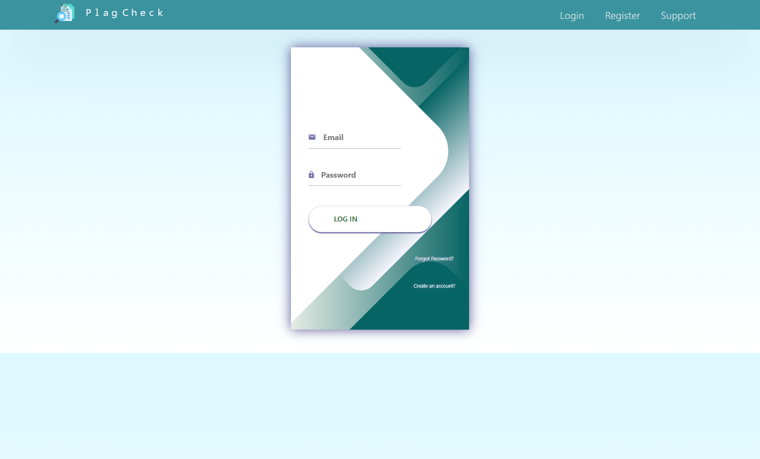
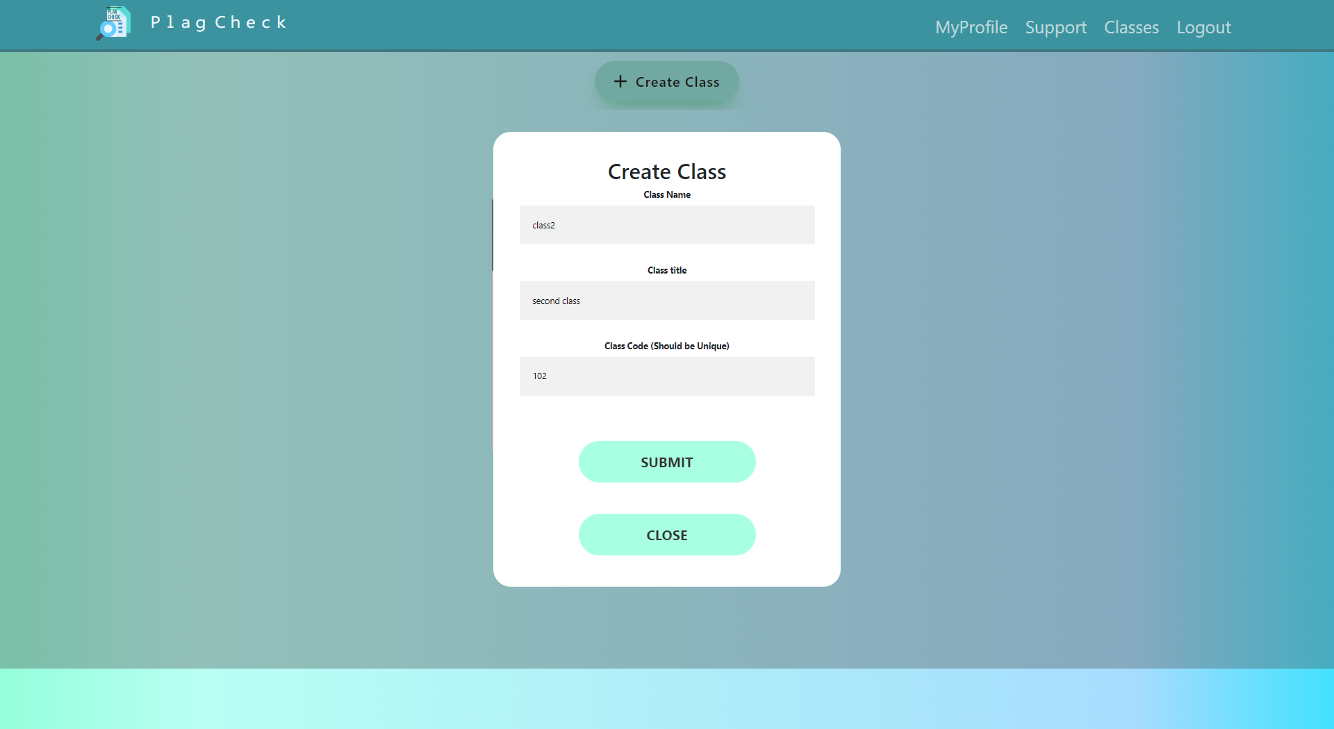
2) LOGIN
3) CREATE CLASS
TEST CASES | RESULT
Login with correct email and password | Logged in Successfully
Login with wrong email and password | Wrong credentials error
Login with correct email and wrong password | Wrong credentials error
TEST CASES | RESULT
Creating class with empty fields | Fill data correctly / Class already exists
Creating class with already existing class code | Fill data correctly / Class already exists
Filling unique class code and other details correctly | class created successfully

Slide 9
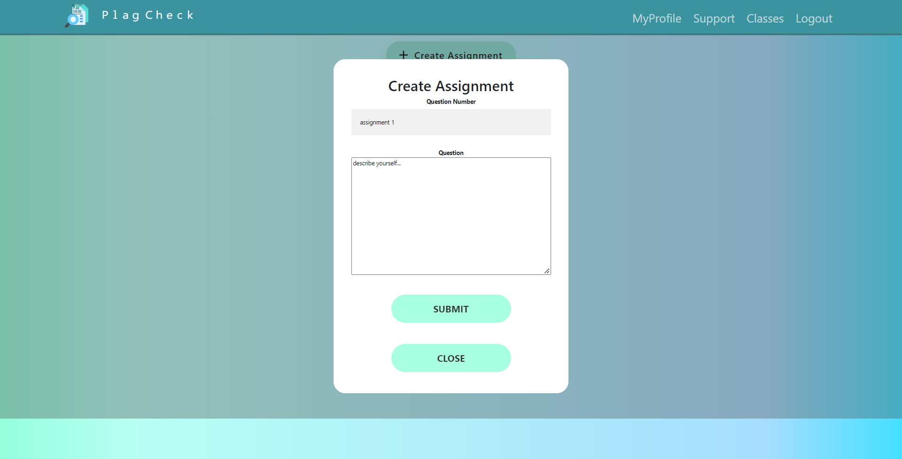
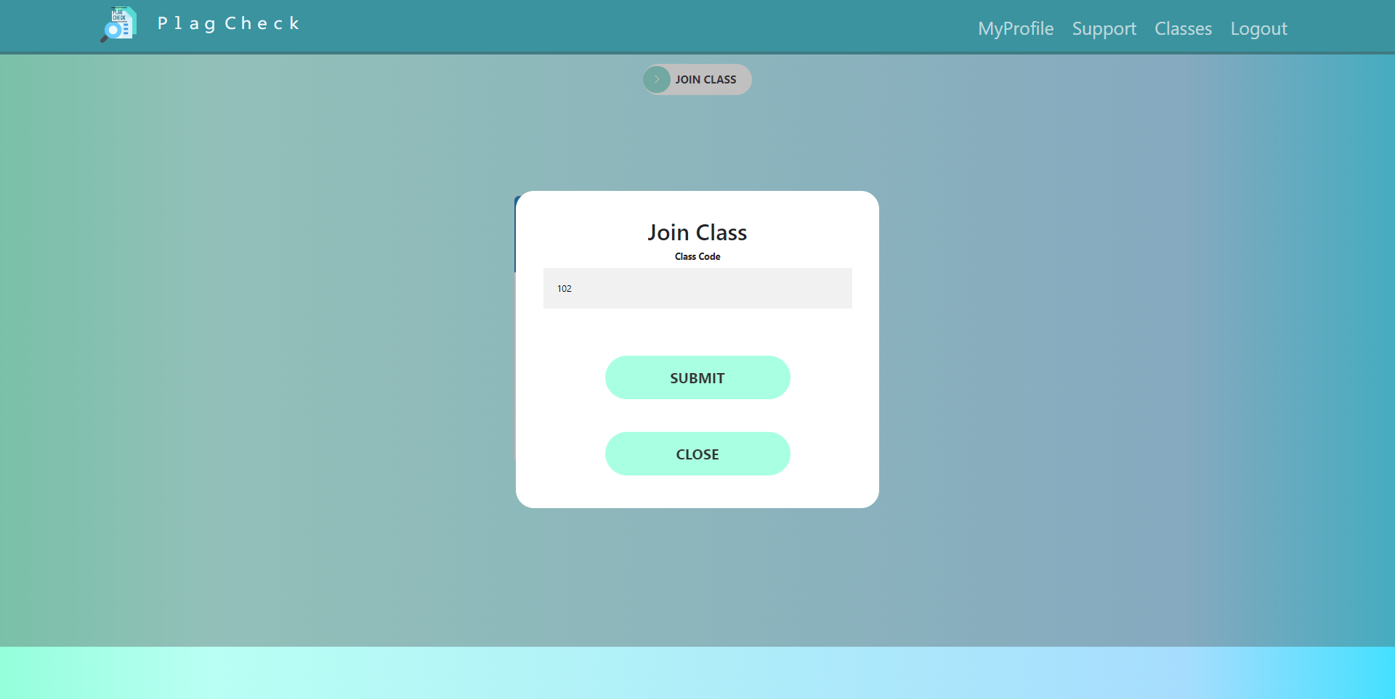
4) CREATE ASSIGNMENT
5) JOIN CLASS
TEST CASES | RESULT
Create assignment with correct required details | Assignment Created Successfully
Create assignment with incomplete details | Please fill the data correctly
TEST CASES | RESULT
Joining class with incorrect class code | Class does not exists or already joined!
Joining class with correct class code | Joined class successfully

Slide 10
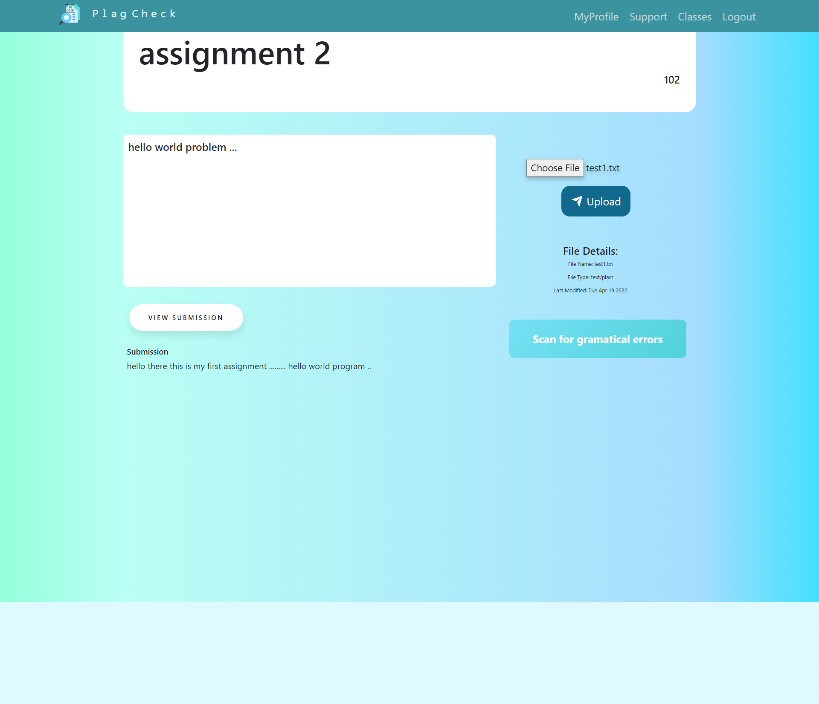
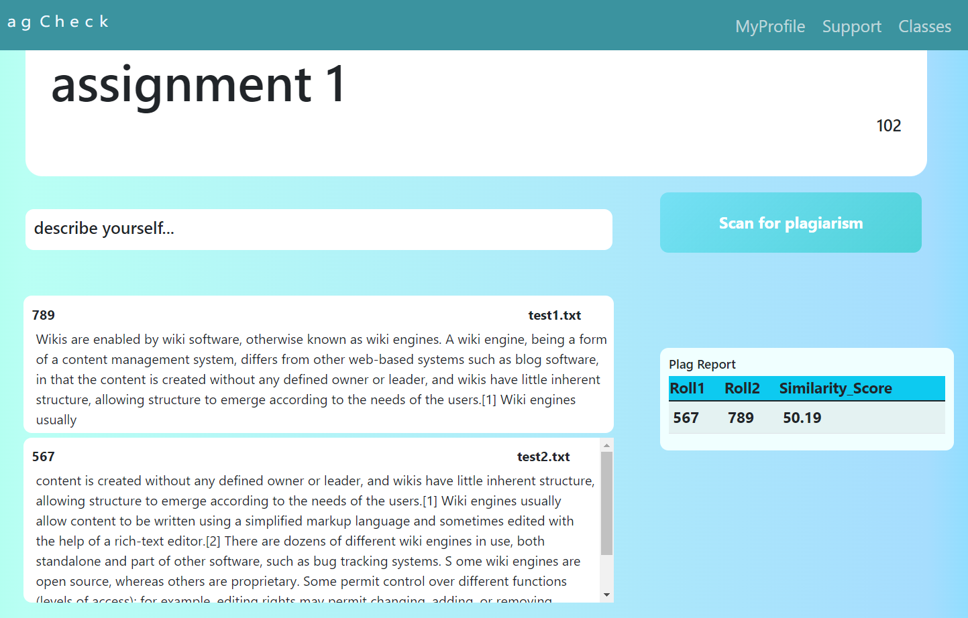
6) SUBMIT ASSIGNMENT
7) VIEW ASSIGNMENT/ SUBMISSIONS
TEST CASES | RESULT
Submitting assignment after already submitted once | Already exists
Uploading file and submitting correctly | Successful
TEST CASES | RESULT
Viewing assignment when no submissions are made | No response
After successful submission | Submission loads successfully

Slide 11
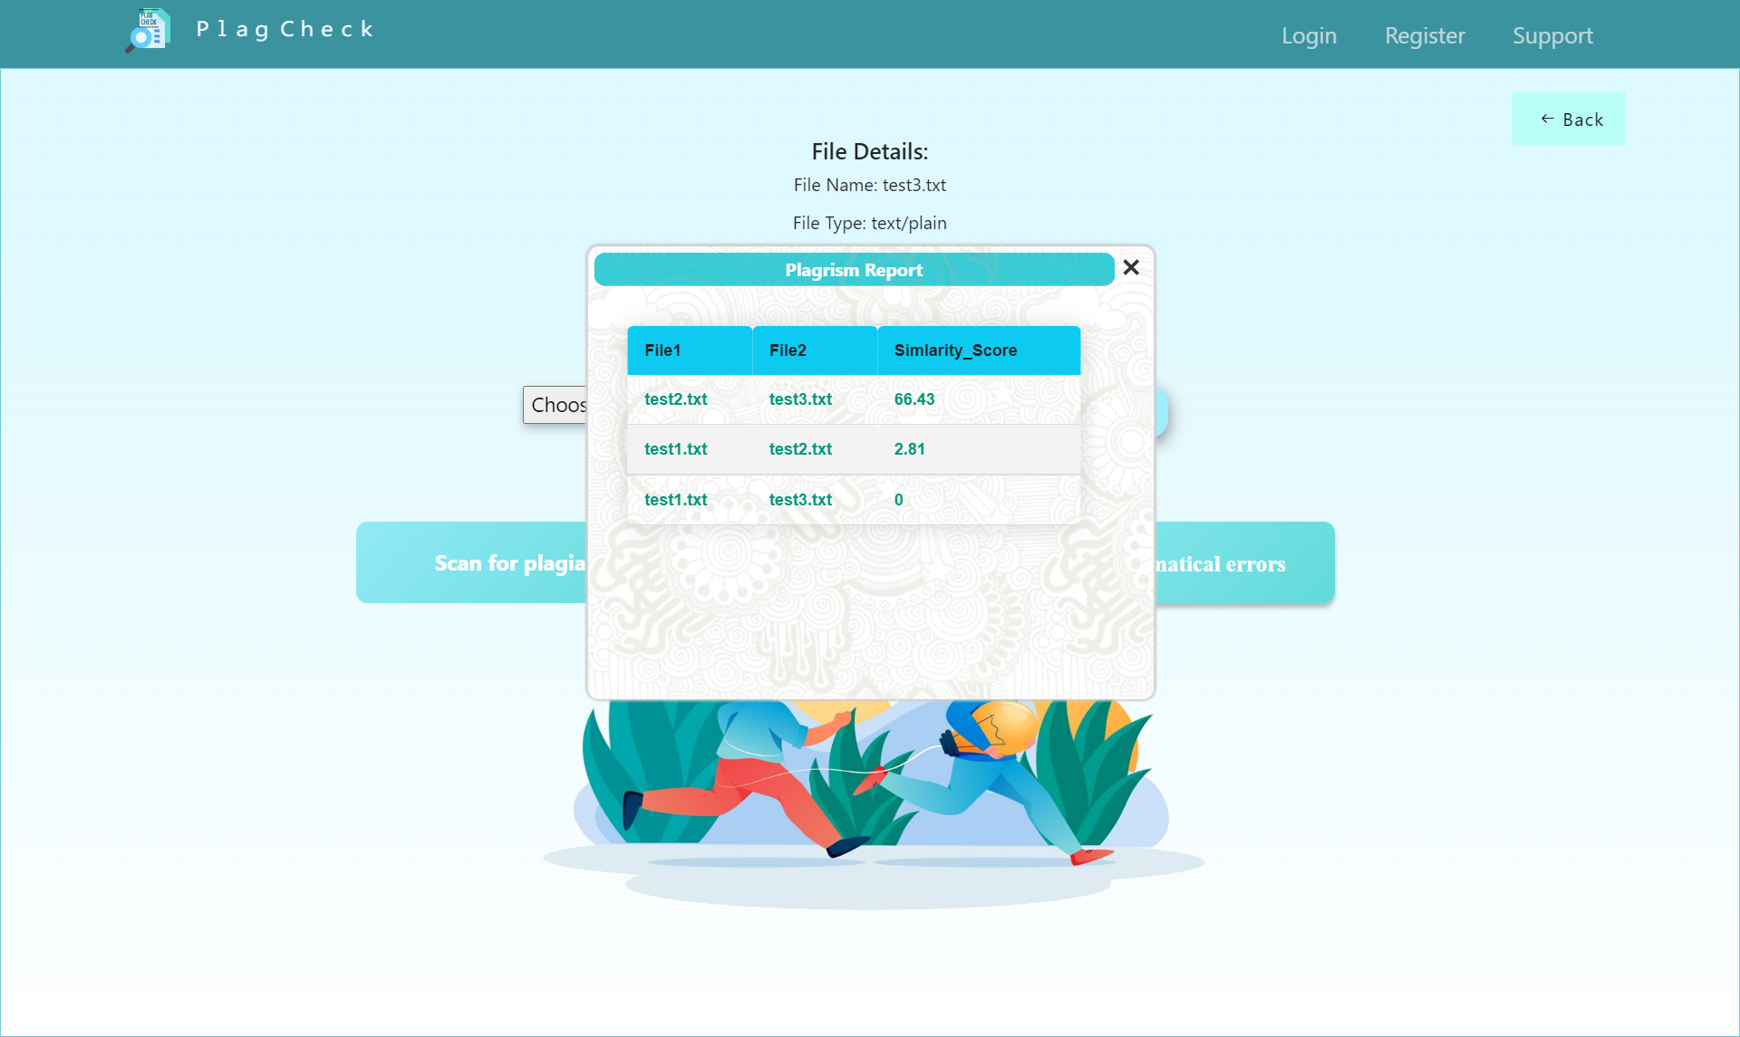
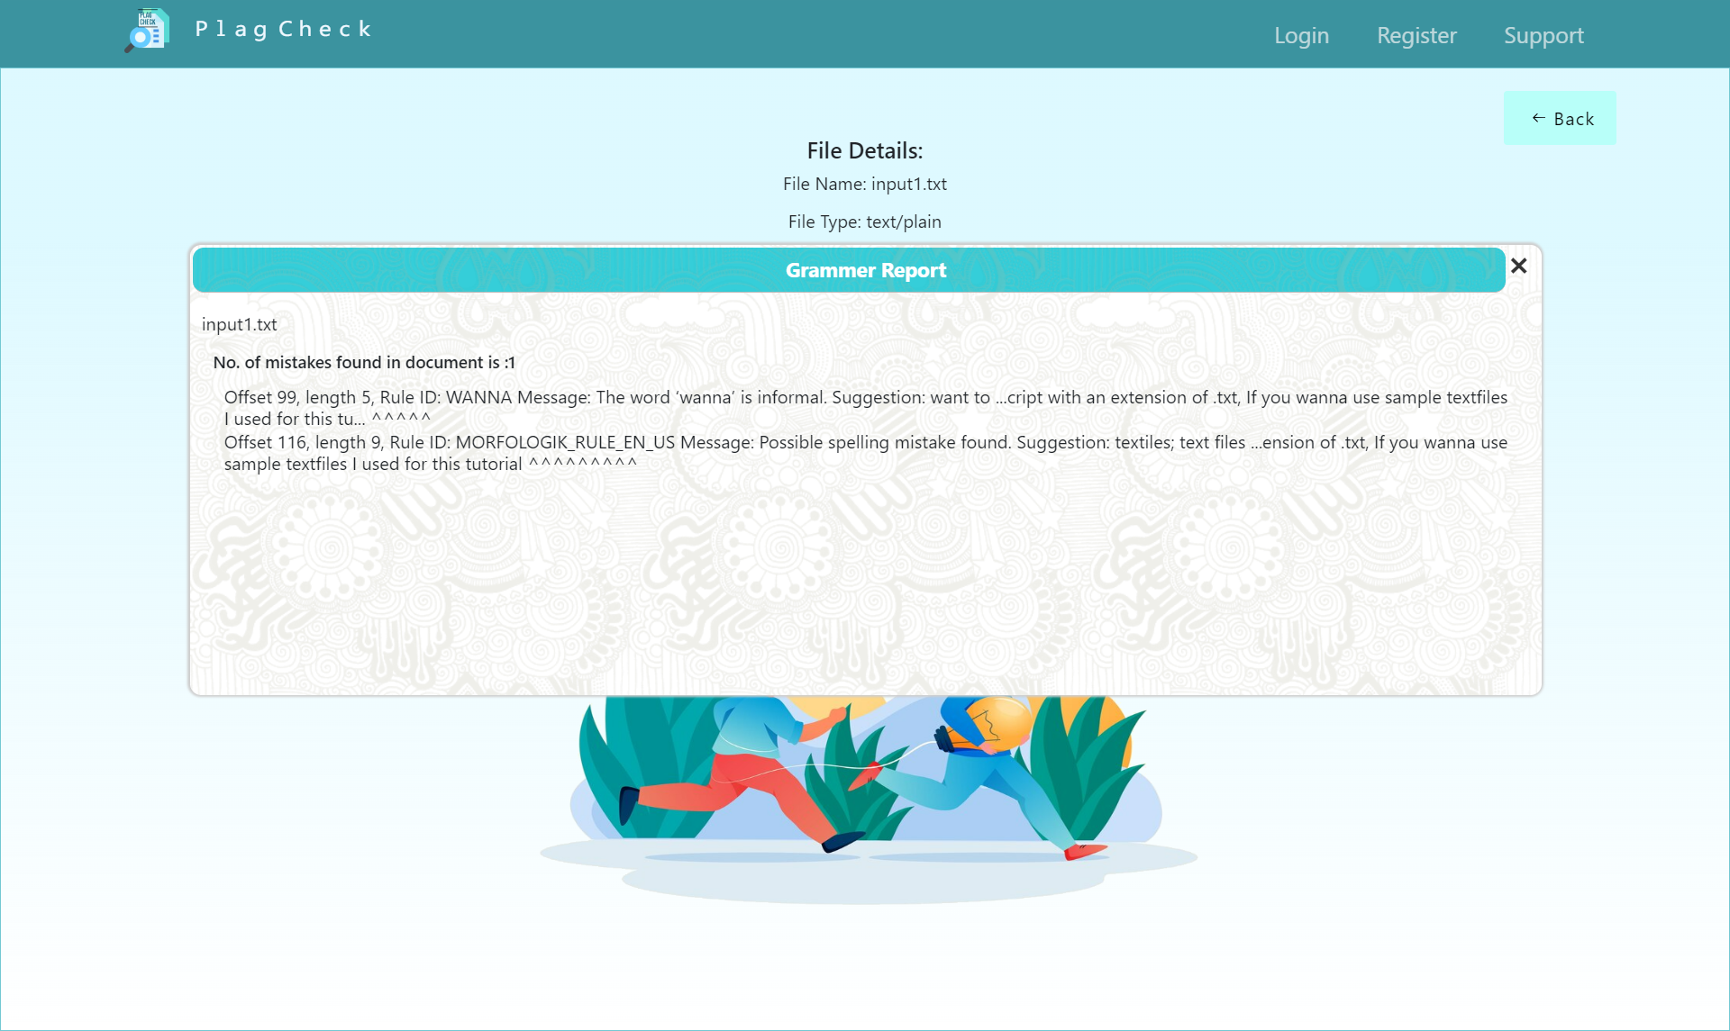
8) VIEW PLAGIARISM REPORT/ GRAMATICAL REPORT
TEST CASES | RESULT
After uploading files successfully | Reports loads successfully
When no file is submitted | No response

Slide 12
We made sure that none of the features are breaking and the system as a whole is working smoothly in all circumstances .

